Slide 1
DATA MINING

Slide 2
INTRODUCTION
Getting at the hard-won sequence and structure data in molecular biology databases and the functional data in the online biomedical literature is complicated by the size and complexity of the databases
Sometimes it would be incorrectly that certain data are contained in a database. However, exhaustively searching for the raw data and performing the transformation and manipulations on the data through manual operations is often impractical
The time and computational resources required to locate and manipulate the data are limiting factors.
Camouflaged by the size and complexity of a database, the millions of data points from genomic or proteomic studies are of little value. Only when these data are categorized according to a meaningful theme are they useful in furthering our understanding of sequence, structure, or function. whether this categorization is at the base pair, chromosome, or gene level, an organizing theme is critical because it simplifies and reduces the complexity of data

Slide 3
What is Data mining?
An alternative to manual searching and one that has had considerable success in the travel, banking, and telecommunications industries—is to use computer-mediated data mining
Data Mining is the process of automatically extracting meaningful patterns from usually very large quantities of seemingly unrelated data
data mining can initiate queries that aren't limited to the user's fluency in authoring effective database queries.
data mining allows the researcher to use her highly advanced pattern-recognition skills and knowledge of molecular biology to determine which results warrant further study
For example, mining the millions of data points from a series of microarray experiments might reveal several clusters of data, as visualized in a 3D cluster display. The researcher could then select data belonging to one or more of the clusters and use a variety of tools to determine the parameters that distinguish it from the other data.

Slide 4
The aim is to explore datamining techniques as an automated means of reducing the complexity of data in large bioinformatics databases and of discovering meaningful, useful patterns and relationships in data
.The "Methods" section explores data mining from the perspective of the process of knowledge discovery.
"Technology Overview" reviews the underlying computer infrastructure and algorithms that make data mining a practical endeavor.
"Infrastructure" reviews the hardware and software requirements of an efficient data-mining operation. “
Pattern Recognition and Discovery" explores the basic pattern recognition process and how it can be extended to pattern discovery.

Slide 5
The "Machine Learning" section reviews the numerous technologies that can be applied to support data mining, from neural networks to Hidden Markov Models.
"Text Mining" focuses on the importance of mining the biomedical literature for data on functions to complement the sequence and structure data mined from nucleotide and protein databases
. The "Tools" section introduces some of the practical general-purpose and bioinformatics specific tools available for data mining.
The "On the Horizon" section looks at the leading-edge data-mining technologies, especially real-time transaction monitoring that promises to decrease the infrastructure requirements.
The "Endnote" section explores the long-term role of machine learning versus human-directed data-mining efforts.

Slide 6
A data warehouse is a central database in which data have been combined from a variety of non-compatible sources, such as sequencing machines, clinical systems, textual bibliographic databases, or national genomic databases.
The advantage of using a data warehouse approach to data mining is timesaving

Slide 7
Methods
Selection and sampling of the appropriate data from the database(s)
preprocessing and cleaning of the data to remove redundancies, errors, and conflicts
Transforming and reducing data to a format more suitable for the data mining
Data mining
Evaluation of the mined data
Visualization of the evaluation results
Designing new data queries to test new hypotheses and returning to step 1

Slide 8
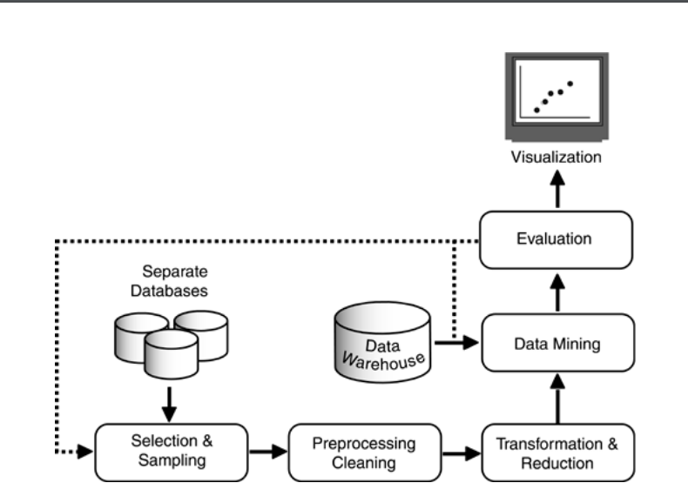

Slide 9
Selection And Sampling
Because of practical computational limitations and a priori knowledge, data mining isn't simply about searching for every possible relationship in a database.
In a large database or data warehouse, there may be hundreds or thousands of valueless relationships
Because there may be millions of records involved and thousands of variables, initial data mining is typically restricted to computationally tenable samples of the holding in an entire data warehouse.
The evaluation of the relationships that are revealed in these samples can be used to determine which relationships in the data should be mined further using the complete data warehouse. With large, complex databases, even with sampling, the computational resource requirements associated with non-directed data mining may be excessive. In this situation, researchers generally rely on their knowledge of biology to identify potentially valuable relationships and they limit sampling based on these heuristics

Slide 10
Thank you

